Slide 1
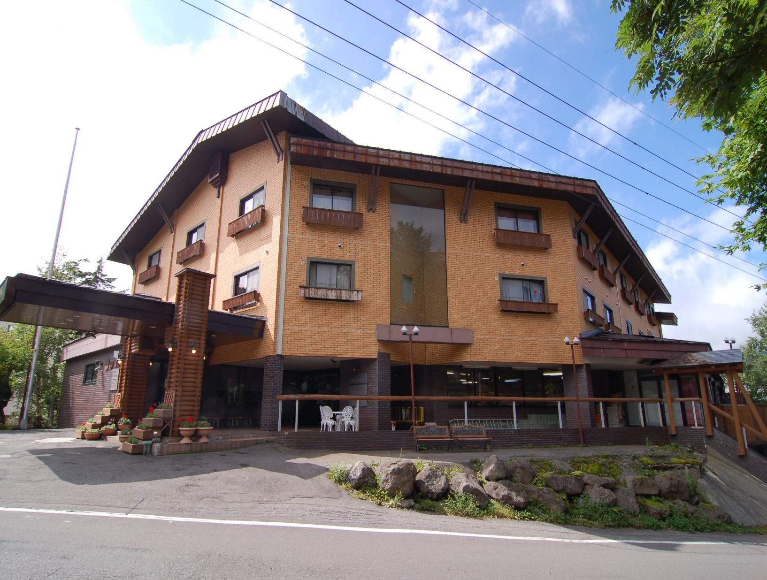
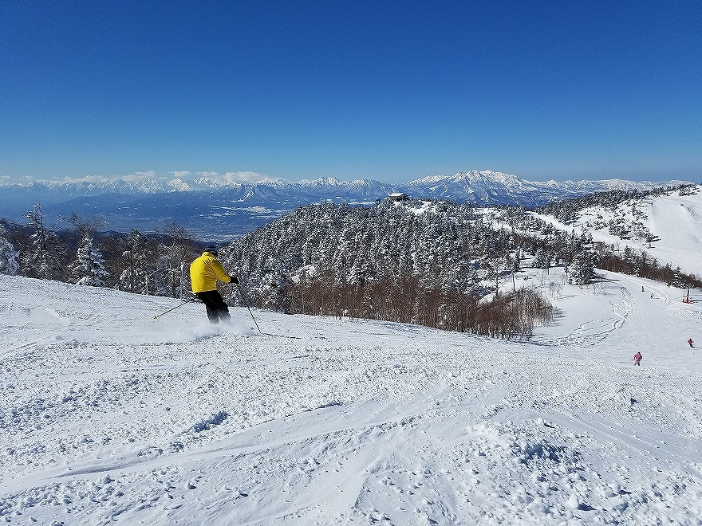
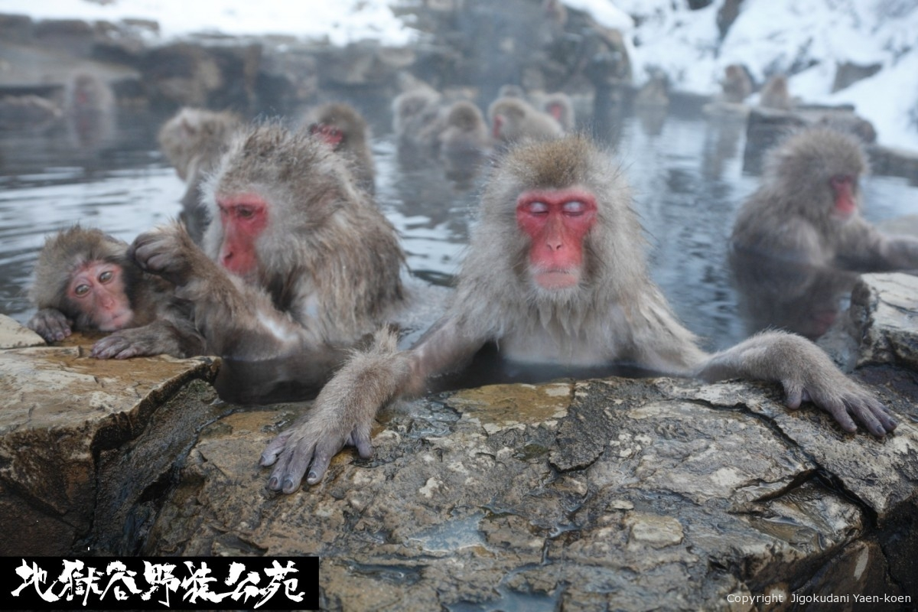


SHIGA ICHII HOTEL
Warm Hospitality
&
Great Location
Best Ski Resort SHIGAKOGEN
&
Japow
&
Snow Moneky
Official HP
Proposal Document

Slide 2
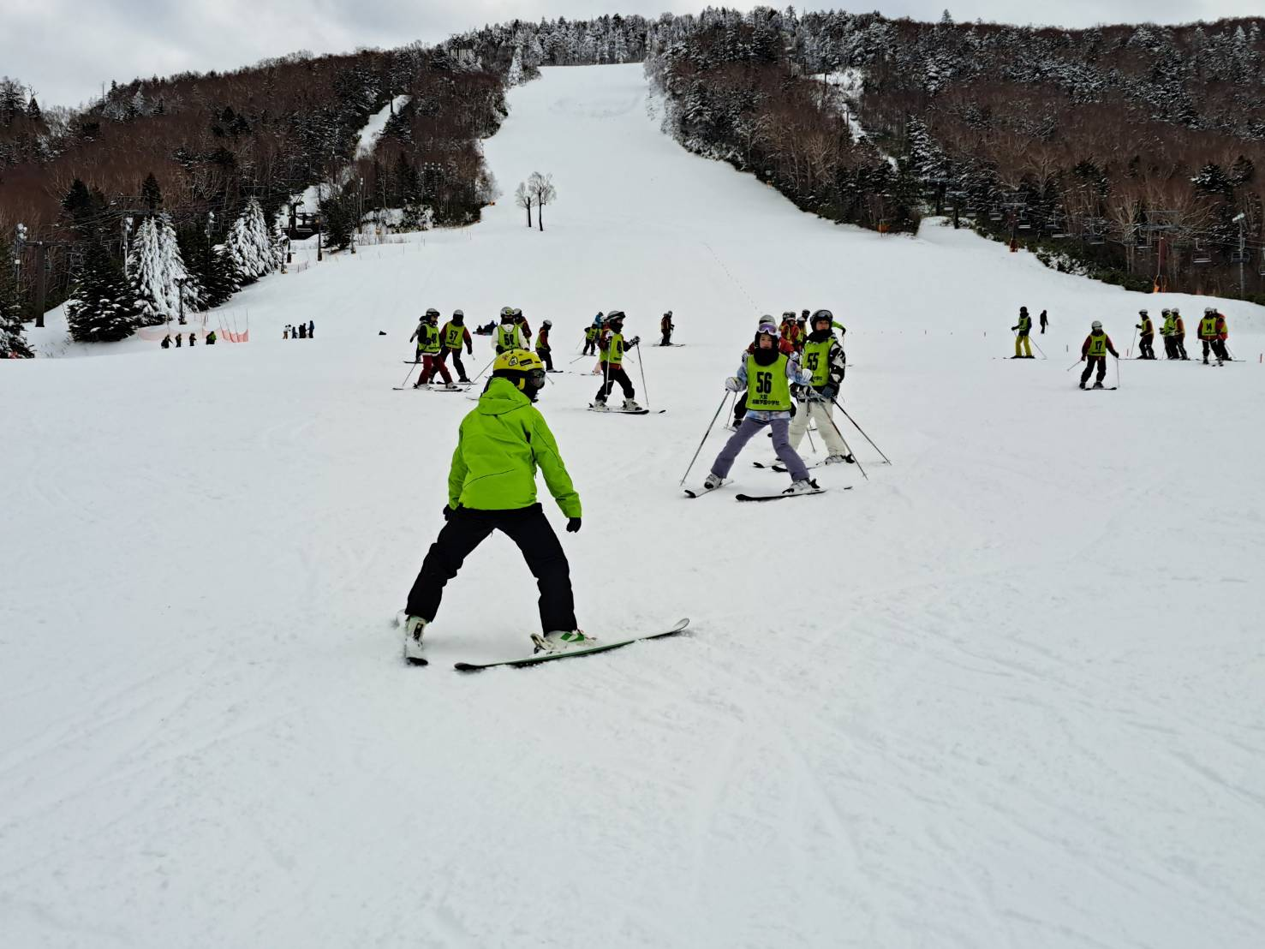
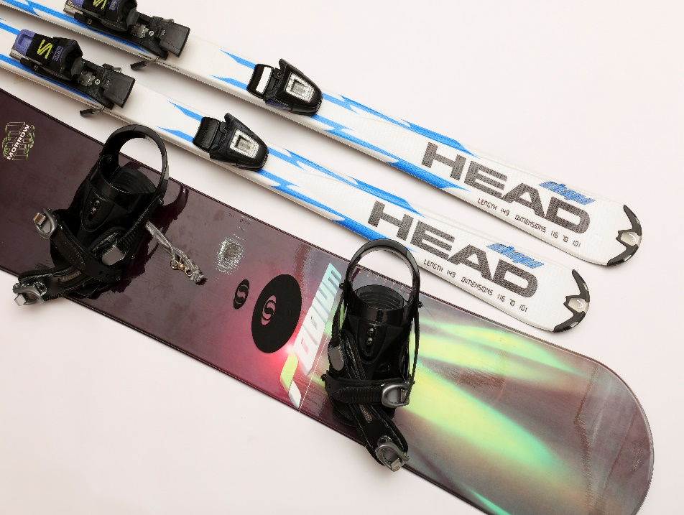
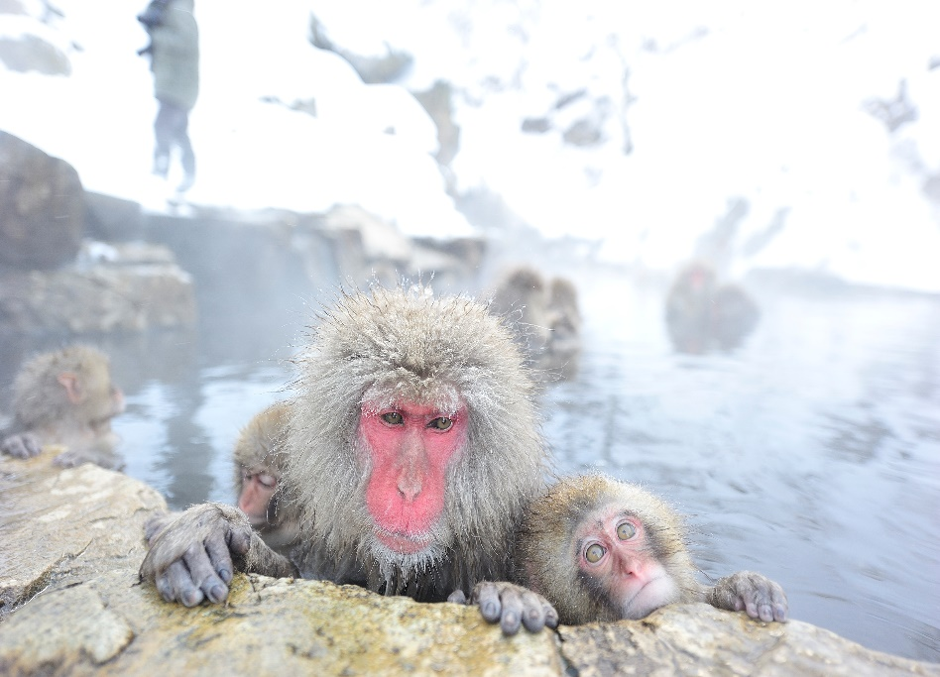
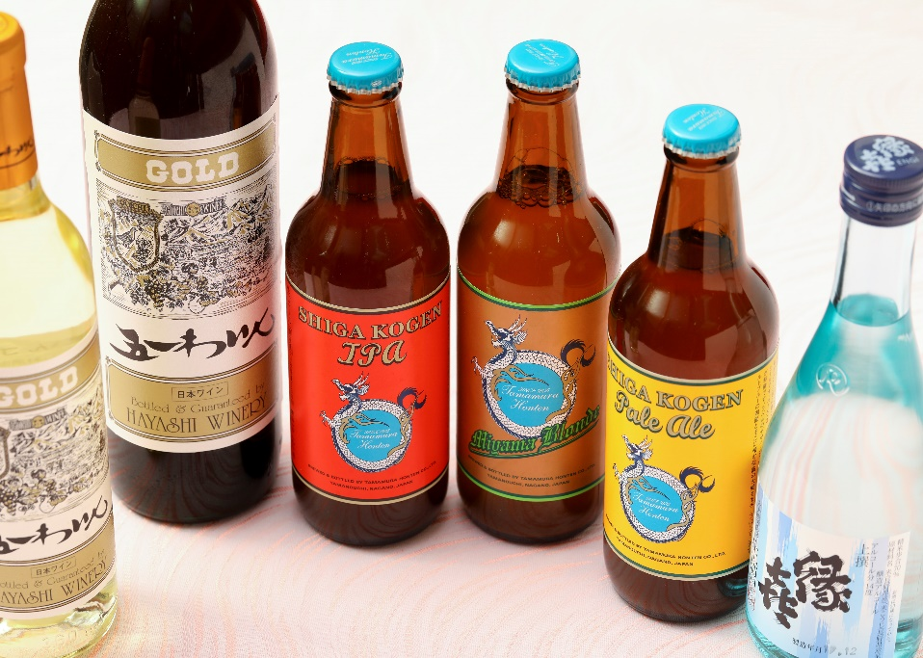
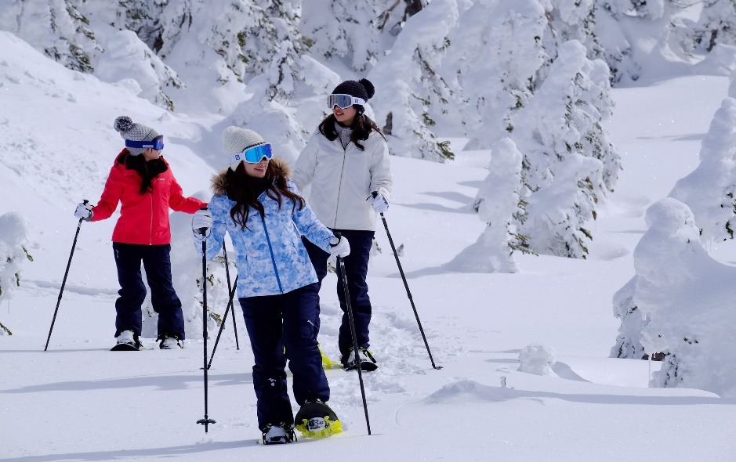
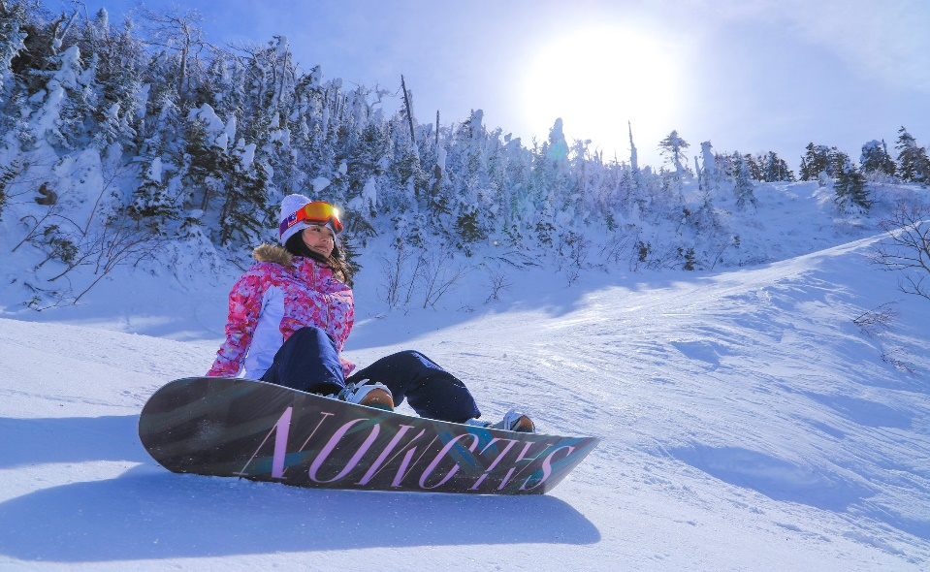
Why you choose Shiga Ichii Hotel
Best Stay for ski
Shiga Ichii Hotel is located in Ichinose where is center of Shigakogen.
! Selection 6 Points ! 1. Great Location 30 seconds to Bus Stop “Ichinose” 1 min to Ski Area 2. Service Ski School English Speakers High grade - Ski gear Rental 3. After Ski Contents Only 1min to Bar / Izakaya / Yakiniku etc..
4. English speakers Guest Relation Arrange the Ski & Snow Monkey Tour
5. Best Rate in Shigakogen
6. Good Facilities Laundry Service / Souvnior Shop / Bar etc…

Slide 3
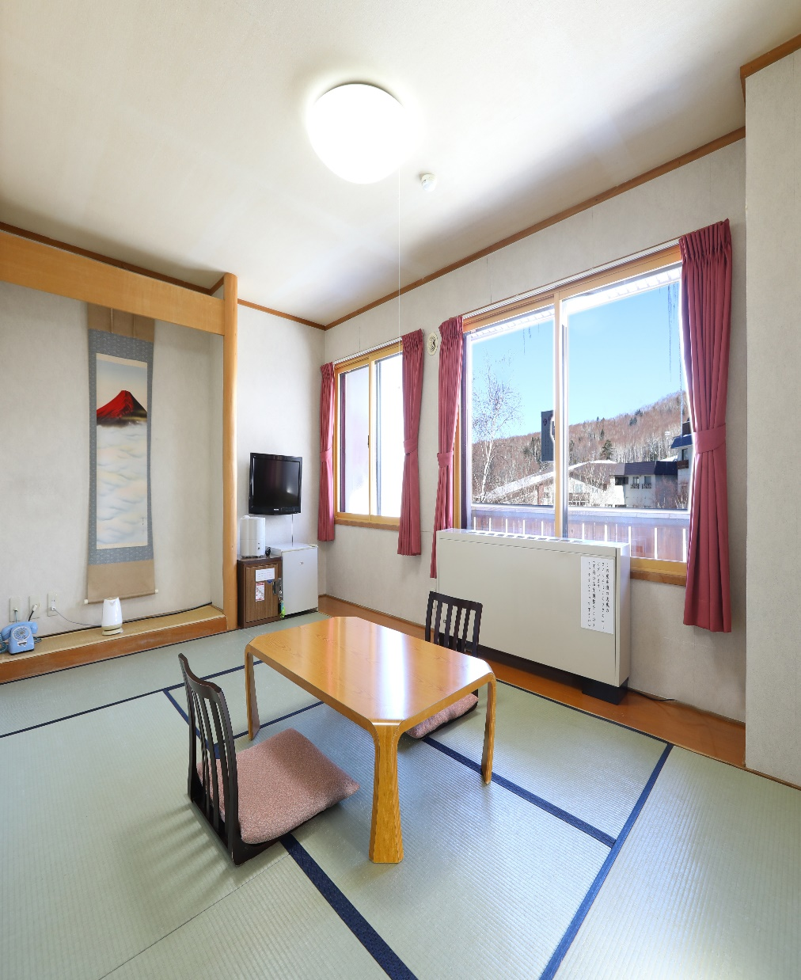
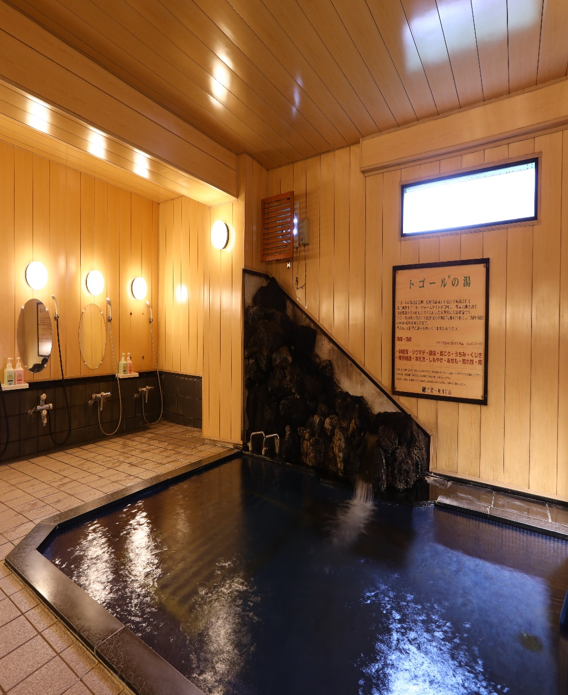
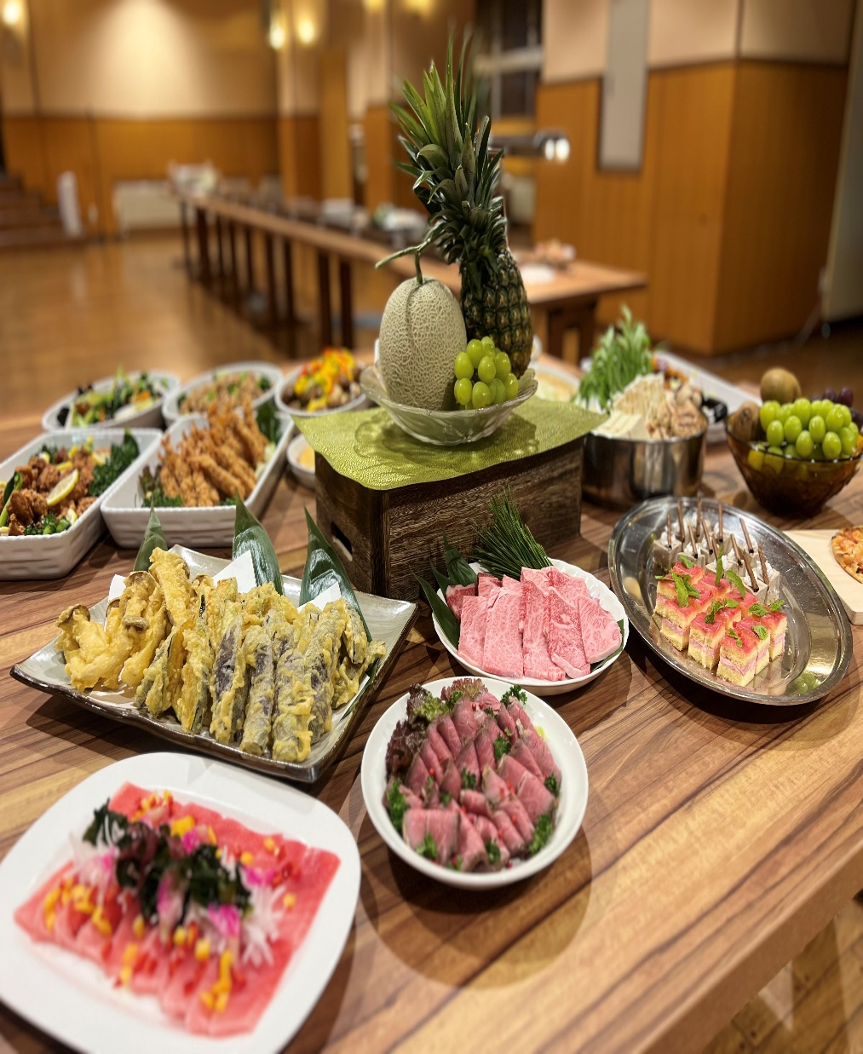
Traditional Japanese Tatami Room
Meals
Two Chefs provide best meals in Shigakogen.
Normally Buffet Style with combine Japanese / Western and Chinese.
Café&Bar New Open !!
Ausutrilian runs bar. They serve alcohol and snack, so you can enjoy night life in my hotel.
Total 50 Rooms
In detail, 36 room with Bath room and all room with washer toilet.
Most of rooms are mountain and city view.
Shiga Ichii Hotel Tips
Onsen
Man-made Onsen.
Great reputation from guest.
It is good for your tired body and encourage to have a good rest.

Slide 4
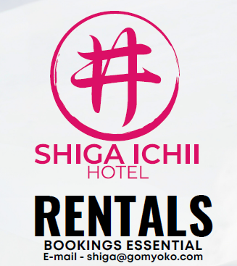

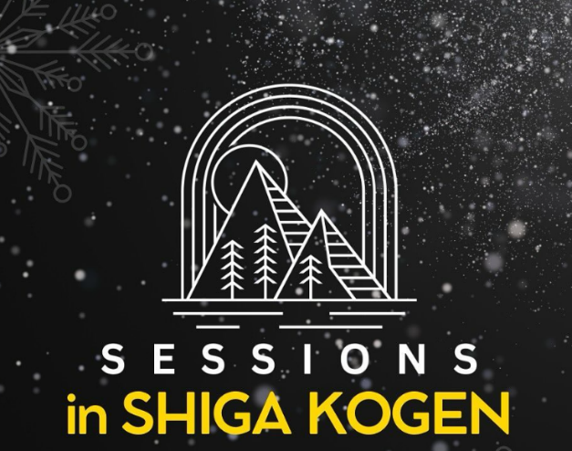

Shiga Ichii Hotel Service
International Ski School
International Café & Bar
International Ski Rental
Land operator service in Shigakogen
Professional Ski and Snowboard lessons for all abilities
8 foreigners instructors will always stay in Shiga Ichii Hotel.
The Only the place where foreigners operate the bar in Shigakogen.
Beer / Wine / Snack etc..
Regularly held event like Karaoke night etc..
The Only the place where foreigners operate ski rental shop in Shigakogen.
Every gear is high level with great price
Arrange Snow Monkey Bus tour / The biggest Food Area (IEON mall) / Other winter activites

Slide 5
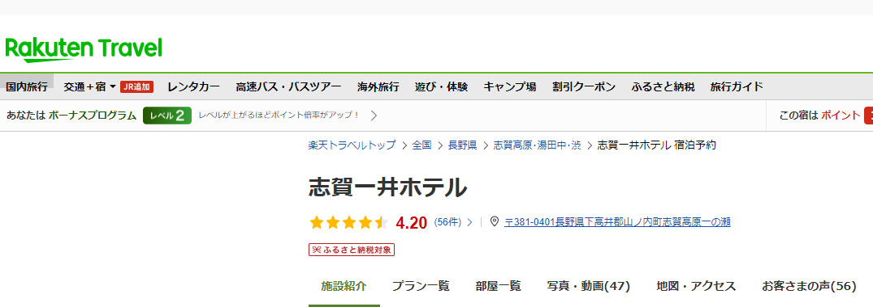
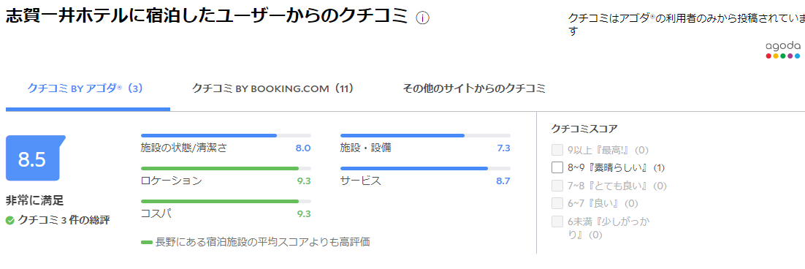
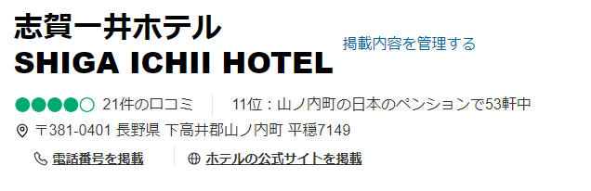
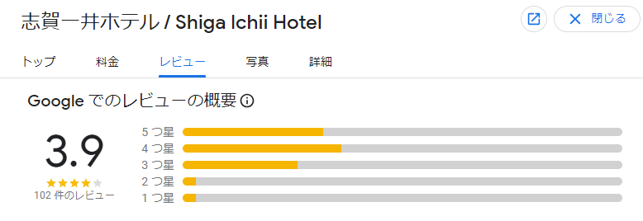
Great Reputation
Shiga Ichii has high scores of customer Reviews
Rakuten, Agoda, Expedia, Trip Adovisors, Google etc…
R|R

Slide 6
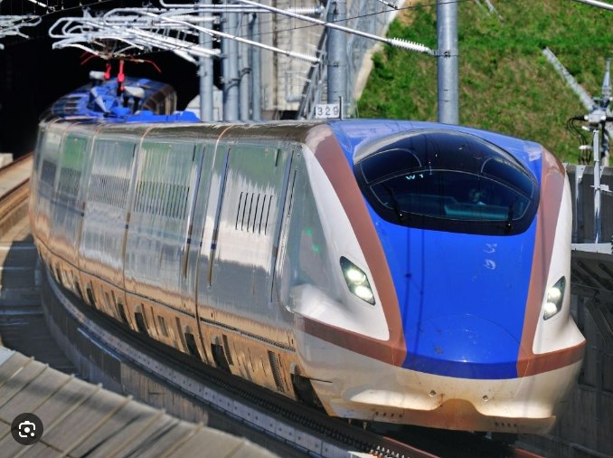
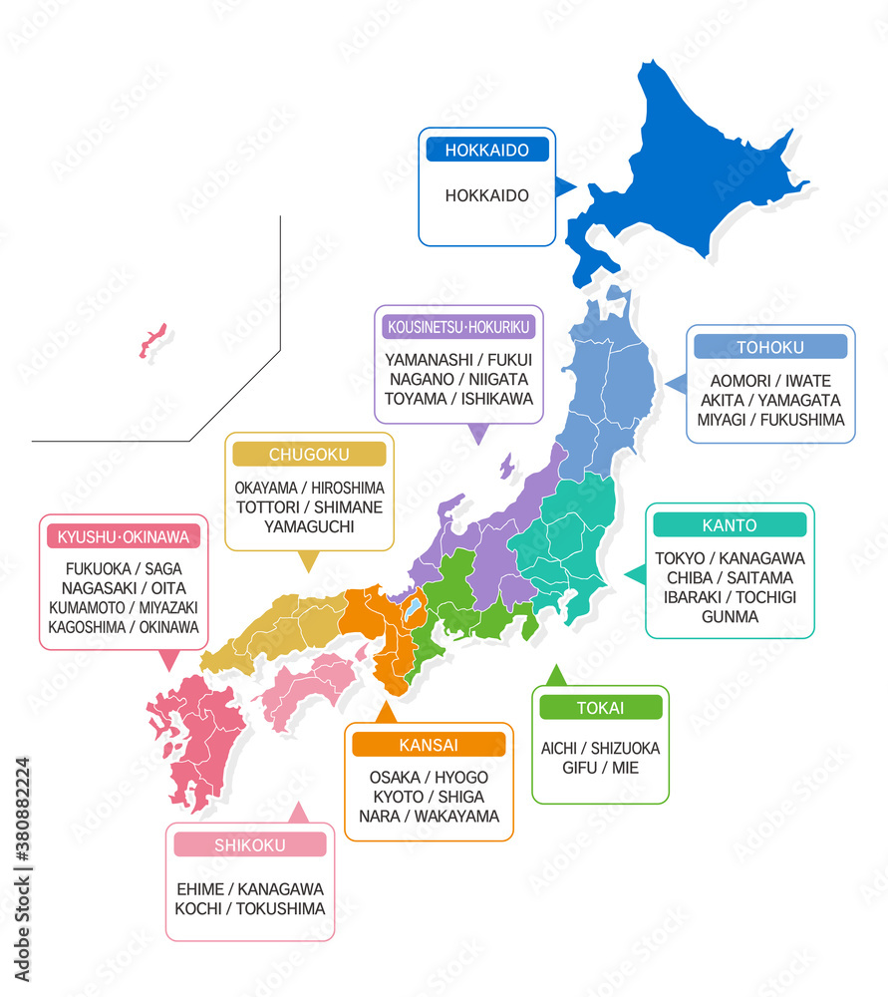
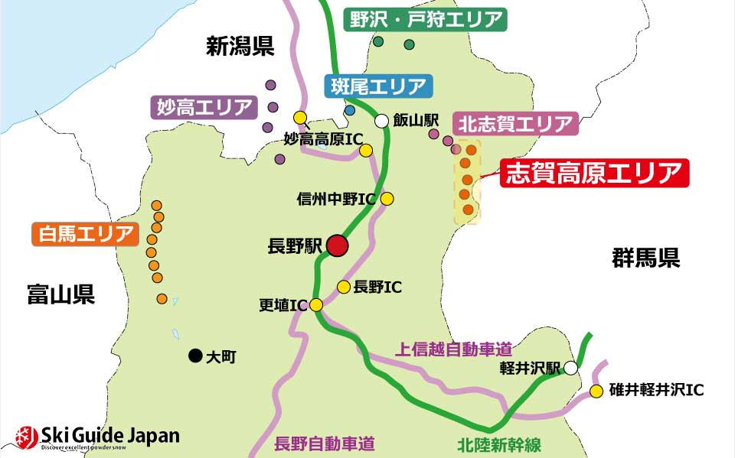
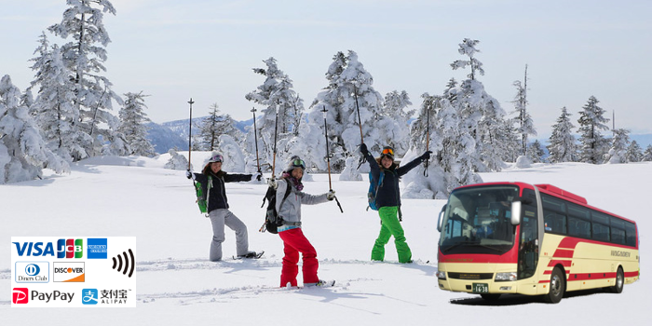
Bullet Train
How you access
Take the Bullet Train and get off at JR Nagano Station.
It takes only around 2 hours from Tokyo Station to Nagano Station.
Shigakogen Express Bus
Shigakogen is located in Nagano prefecture.
It is surrounded by Myoko, Nozawa, Hakuba
Take Express Bus from Nagano station and get off Ichinose.
It takes only 1.5 hours from Nagano Station to Ichinose (S24)

Slide 7
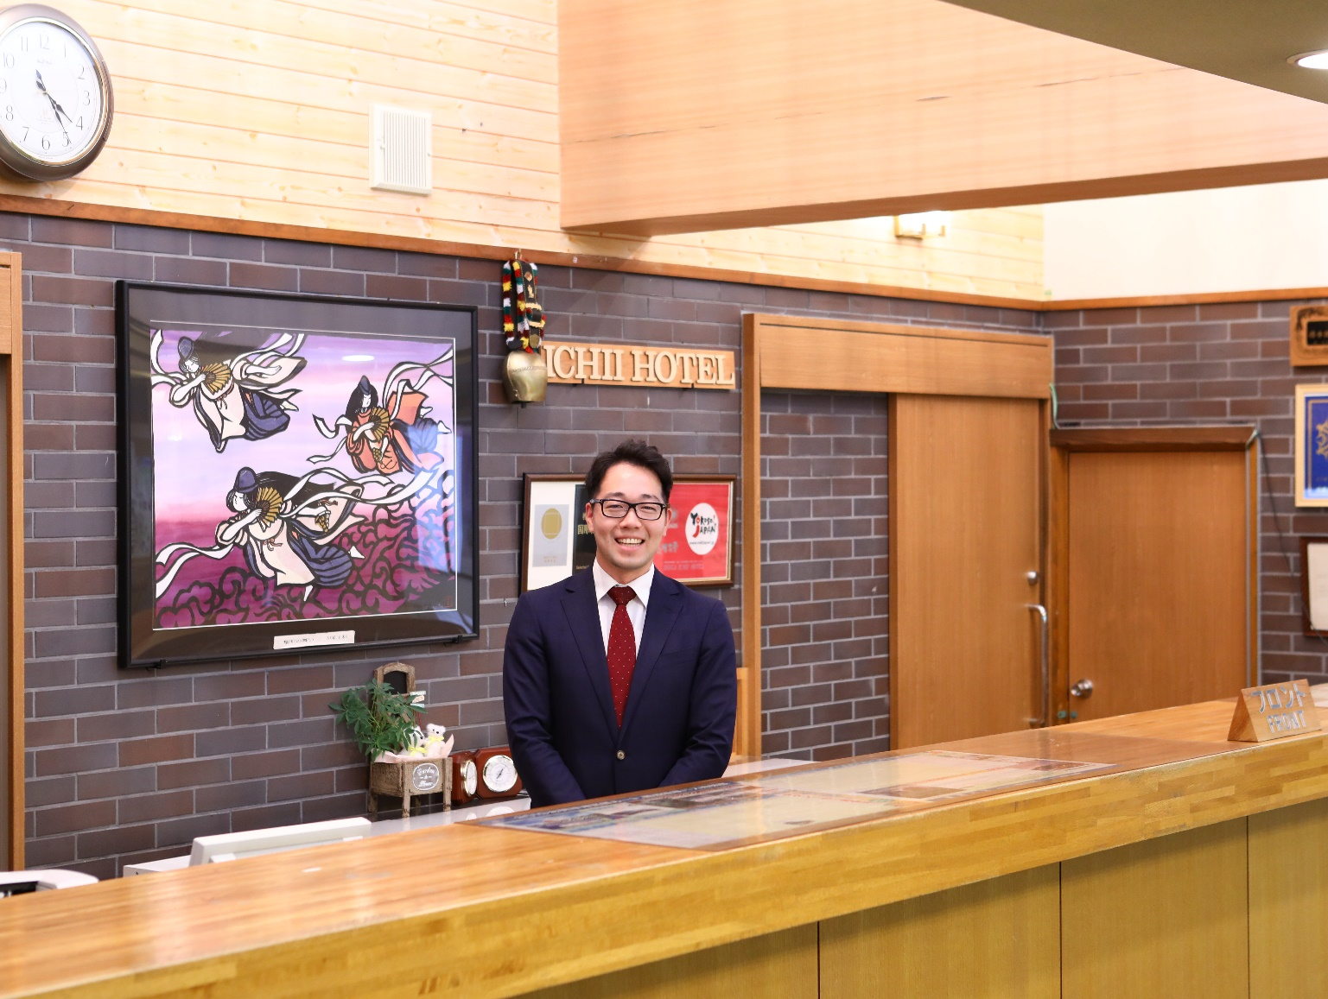
Look Forward to Seeing you in Shiga Ichii Hotel
For questions, requests and anything else we can help you with, please email us at info@shigaichii.jp
Person in charge: Mr. Kodama

